Slide 1


CROP CORE TECH
FARMING RIGHT, PROFITS IN SIGHT.
-> INNOVATIVE SOLUTIONS FOR MODERN FARMING.
-> Data-Driven Insights for Enhanced Productivity.
-> Empowering Sustainable Agriculture.
-> Maximizing Yield, Minimizing Impact.
-> Driving Innovation in Crop Management.

Slide 2

-> Number of Users: 120
-> New Users (20% growth rate): 120
-> Revenue:
: Sensor Installation Revenue: ₹12,00,000
: Subscription Revenue: ₹28,320
-> Total Revenue: ₹12,28,320
->Costs:
:Annual Server Cost: ₹10,000
:Monthly Expenses: ₹6,00,000
:Sensor Installation Costs: ₹9,60,000
->Total Costs: ₹15,70,000
-> Net Profit/Loss: (₹3,41,680)
-> Profit/Loss Status: Loss
Year 1 Profit Projection

Slide 3

Year 2 Profit Projection
-> Number of Users: 288
-> New Users (20% growth rate): 168
-> Revenue:
:Sensor Installation Revenue: ₹16,80,000
:Subscription Revenue: ₹67,968
:Total Revenue: ₹17,47,968
-> Costs:
:Annual Server Cost: ₹10,000
:Monthly Expenses: ₹6,00,000
:Sensor Installation Costs: ₹13,44,000
:Total Costs: ₹19,54,000
-> Net Profit/Loss: (₹2,06,032)
-> Profit/Loss Status: Loss

Slide 4

Year 3 Profit Projection
-> Number of Users: 518
-> New Users (20% growth rate): 230
-> Revenue:
:Sensor Installation Revenue: ₹23,00,000
:Subscription Revenue: ₹1,22,248
:Total Revenue: ₹24,22,248
-> Costs:
:Annual Server Cost: ₹10,000
:Monthly Expenses: ₹6,00,000
:Sensor Installation Costs: ₹18,40,000
:Total Costs: ₹24,50,000
-> Net Profit/Loss: (₹27,752)
-> Profit/Loss Status: Loss

Slide 5

Year 4 Profit Projection
-> Number of Users: 1,241
-> New Users (20% growth rate): 723
-> Revenue:
:Sensor Installation Revenue: ₹72,30,000
:Subscription Revenue: ₹2,92,876
:Total Revenue: ₹75,22,876
-> Costs:
:Annual Server Cost: ₹10,000
:Monthly Expenses: ₹6,00,000
:Sensor Installation Costs: ₹57,84,000
:Total Costs: ₹63,94,000
-> Net Profit/Loss: ₹11,28,876
-> Profit/Loss Status: Profit

Slide 6
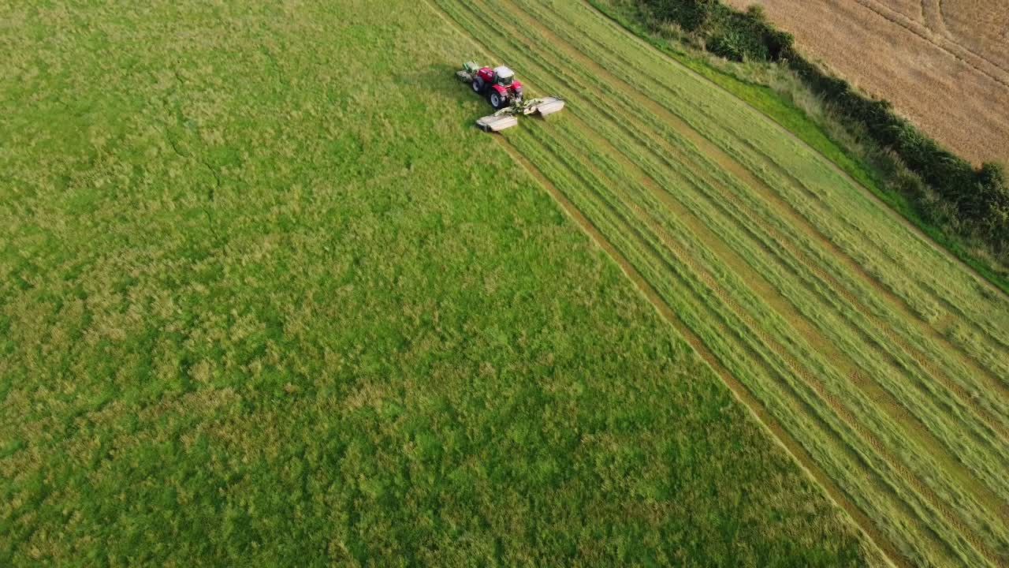
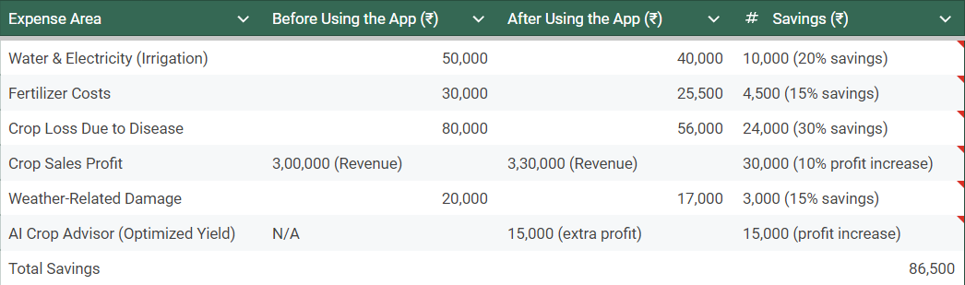
REDUCTION IN COST
NOW
*National Bank for Agriculture and Rural Development (NABARD) annual reports
*Commission for Agricultural Costs and
Prices (CACP)

Slide 7
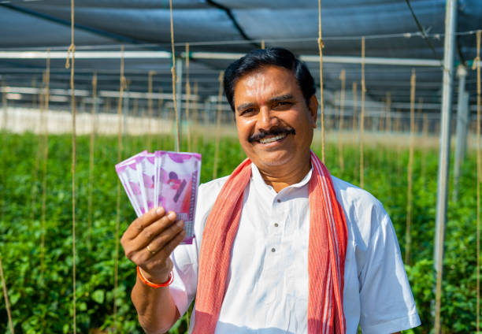

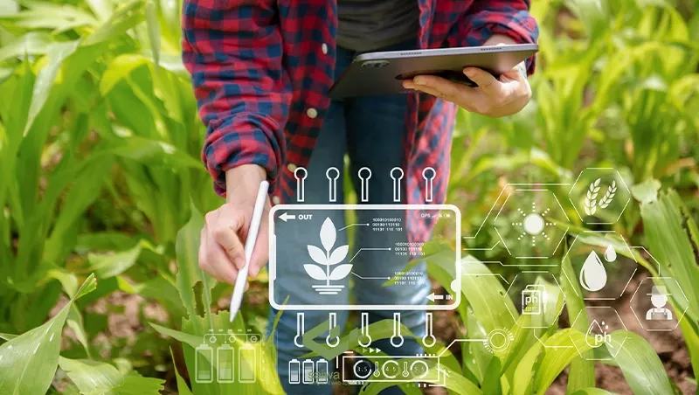
Farmers’
Financial Balance
-> First Year: The farmer spends ₹10,000 on sensor installationand ₹196 on the app subscription but saves ₹86,500 in operational costs and increased revenue. This results in a net financial gain of ₹76,304 in the first year alone.
-> Subsequent Years: From the second year onwards, the farmer only pays for the app subscription, so the net financial benefit increases to ₹86,304 annually.
Over a 5-year period: a farmer could save up to ₹4,31,520 using the app (₹86,304 x 5), significantly improving their profitability and financial health.

Slide 8
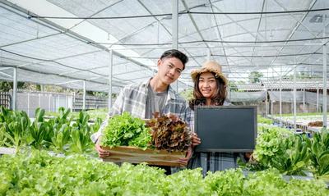
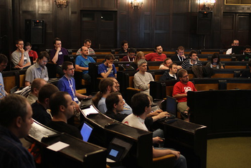
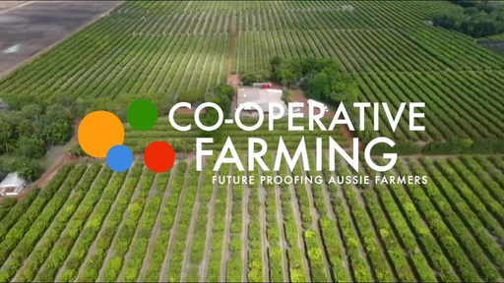
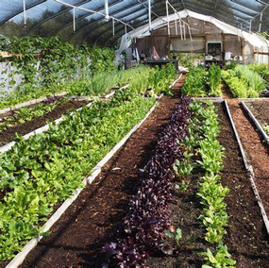
TARGET MARKET
-> Early Adopters: Individuals eager to try new agricultural technologies. Their feedback is crucial for product improvement and influencing others.
OVERVIEW
-> Educational and Research Institutions: Focus on innovative agricultural research and technology. Collaborations enhance student learning and practical skills.
-> Agri-Cooperatives: Farmer groups that collaborate for mutual benefits. They offer opportunities for bulk purchasing and greater technology adoption.
-> Small, Medium, and Urban Farmers: Seek cost-effective, sustainable solutions for improved productivity. Tailored, space-efficient, and resource-conserving support is key.

Slide 9




MARKETING
STRATEGIES
-> Awareness Campaigns: Educate target audiences via social media, local events, and seminars. Collaborate with agricultural influencers to expand reach and credibility.
-> Workshops: Conduct hands-on workshops to showcase product features. Partner with educational institutions and agri-cooperatives to build trust.
->Incentive Programs: Offer discounts, free trials, and referral programs to early adopters. Incentivize long-term user commitments.
-> Digital Marketing: Target urban farmers and students through social media, success stories, and SEO strategies to boost online presence.

Slide 10
CONCLUSION
onc
In summary, Crop-Core Tech is dedicated to revolutionizing modern farming with innovative, data-driven solutions that maximize productivity while promoting sustainability. By empowering farmers with cutting-edge technology and fostering strong partnerships, we are driving growth and profitability in the agricultural sector. Together, we can shape the future of farming—smarter, more efficient, and more sustainable.

Slide 11
Thank
You!
FARMING SMARTER
PROFITING TOGETHER.
CACHE ME
PRANNAVAKHANTH
VENKATAKRISHNAN
HARIPRASAADH
KALYAN SUDARSAN
LOHITA LAKSHMI
MITIL GIRISH

